Slide 1
Chapter
1
Business Information Systems in Your Career
Notes:
There are two video cases available for this chapter:
Case 1: UPS Global Operations with the DIAD
Case 2: Google Data Center Efficiency Best Practices

Slide 2
Essentials of Management Information Systems
Chapter 1 Business Information Systems in Your Career
STUDENT LEARNING OBJECTIVES
Why are information systems so essential for running and managing a business today?
What exactly is an information system? How does it work? What are its people, organization, and technology components?
Notes:
Students may not know exactly what is meant by globalization or may have an incomplete understanding of the term. You might ask students what they think it means. What are some examples of globalization in their personal lives? Cars come to mind, but there are thousands of products sold in the United States that are produced offshore. Why is globalization growing in strength? Potential answers could include: reduction of economic and cultural advantages of developed countries, increased number of companies with operations in multiple countries worldwide, and increased reliance on imports and exports of goods (and jobs). Globalization will be discussed in later slides as well.

Slide 3
Essentials of Management Information Systems
Chapter 1 Business Information Systems in Your Career
STUDENT LEARNING OBJECTIVES
How will a four-step method for business problem solving help you solve information system-related problems?
How will information systems affect business careers, and what information systems skills and knowledge are essential?

Slide 4
Essentials of Management Information Systems
Chapter 1 Business Information Systems in Your Career
VIDEO CASES AND LEARNING TRACKS
Learning Tracks
How Much Does IT Matter?
The Changing Business Environment for Information Technology
The Business Information Value Chain
The Mobile Digital Platform
Occupational and Career Outlook for Information Systems Majors 2012-2020
Video Cases
Case 1: UPS Global Operations with the DIAD
Case 2: Google Data Center Efficiency Best Practices
Instructional Video 1: Green Energy Efficiency in a Data Center Using Tivoli Architecture (IBM)
Instructional Video 2: Tour IBM's Raleigh Data Center

Slide 5
Essentials of Management Information Systems
Chapter 1 Business Information Systems in Your Career
RUGBY FOOTBALL UNION TRIES BIG DATA
Problem: Maximizing profits from international ticket sales and vending to support more than 60,000 volunteers.
Solutions: Capture and analyze Big Data.
Notes:
You could ask students if they have been to a major game recently, and if so, what they thought of the experience with the management of the customer experience, from the food to the waiting lines for rides, and what Internet or IT-related services were offered.

Slide 6
Essentials of Management Information Systems
Chapter 1 Business Information Systems in Your Career
RUGBY FOOTBALL UNION TRIES BIG DATA
RFU/IBM uses TryTracker to track keys to the game, momentum and key players. Complemented by traditional rugby statistics
Demonstrates IT’s role in increasing value and revenue in any business.
Illustrates the potential for technology to improve customer experience.
Notes:
Students might not intuitively grasp that a baseball team is like any other business: it needs to make investments in information technologies to run efficient and effective operations.

Slide 7
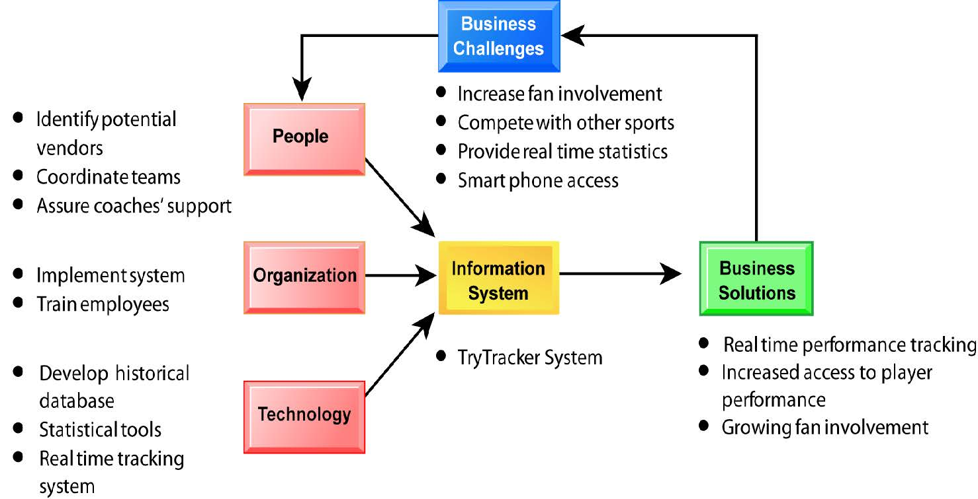
Essentials of Management Information Systems
Chapter 1 Business Information Systems in Your Career
RUGBY FOOTBALL UNION TRIES BIG DATA
Notes:
Can students think of any other business challenges faced by the San Francisco Giants which IT might help to alleviate?

Slide 8
Essentials of Management Information Systems
Chapter 1 Business Information Systems in Your Career
Why are information systems so essential for running and managing a business today?
How Information Systems Are Transforming Business
In 2015, more than 118 million businesses had dot-com addresses registered.
150 million people read news online; 180 million use a social networking site.
Internet advertising continues to grow at around 15 percent per year.
New laws require businesses to store more data for longer periods.
Changes in business result in changes in jobs and careers.
Notes:
Ask students to explain why these items are examples of information systems transforming business. What industries are especially hard hit with disruptions and change due to IT?

Slide 9
Essentials of Management Information Systems
Chapter 1 Business Information Systems in Your Career
Why are information systems so essential for running and managing a business today?
What's New in MIS?
New technologies
Cloud computing / software as a service (SaaS)
Big Data
Mobile digital platform
Management
Managers use social networks, collaboration.
Business intelligence applications accelerate
Virtual meetings proliferate.
Organizations
Social business
Telework gains momentum
Co-creation of value, collaboration across firms

Slide 10
Essentials of Management Information Systems
Chapter 1 Business Information Systems in Your Career
Why are information systems so essential for running and managing a business today?
Interactive Session: People
The Mobile Pocket Office
Read the Interactive Session and then discuss the following questions:
What kinds of applications are described here? What business functions do they support? How do they improve operational efficiency and decision making?
Identify the problems that businesses in this case study solved by using mobile digital devices.
What kinds of businesses are most likely to benefit from equipping their employees with mobile digital devices such as iPhones and iPads?
One company deploying iPhones has said, “The iPhone is not a game changer, it's an industry changer. It changes the way that you can interact with your customers” and “with your suppliers.” Discuss the implications of this statement.
Notes:
Ask students whether or not the smartphones that are changing business have had a similar effect on their own lives. Have iPhones dramatically changed they way they do things or created new possibilities?

Slide 11
Essentials of Management Information Systems
Chapter 1 Business Information Systems in Your Career
Why are information systems so essential for running and managing a business today?
Globalization Challenges and Opportunities:
A Flattened World
Internet and global communications have greatly reduced economic and cultural advantages of developed countries.
  Drastic reduction of costs of operating and transacting on global scale
  Competition for jobs, markets, resources, ideas
  Dependence on imports and exports
  Requires new understandings of skills, markets, opportunities
Notes:
You could ask students to name ways in which globalization affects their everyday lives. Ask them how they might react if they learned that a job opening they coveted was outsourced to another country, or on the other hand, what they would do if they were managers filling a job opening and workers from abroad could fill the spot for a fraction of the cost.

Slide 12
Essentials of Management Information Systems
Chapter 1 Business Information Systems in Your Career
Why are information systems so essential for running and managing a business today?
Business Drivers of Information Systems
Businesses invest in IT to achieve six important business objectives.
  Operational excellence
  New products, services, and business models
  Customer and supplier intimacy
  Improved decision making
  Competitive advantage
  Survival
Notes:
Which objective do students consider to be most important? Ask students to describe their personal business experience as employers (or owners), and to describe which of the above objectives was most important in their firm or job.

Slide 13
Essentials of Management Information Systems
Chapter 1 Business Information Systems in Your Career
Why are information systems so essential for running and managing a business today?
Operational Excellence:
Improved efficiency results in higher profits.
Information systems and technologies help improve efficiency and productivity.
  Example: Walmart
    Power of combining information systems and best business practices to achieve operational efficiency—and over $473 billion in sales in 2014
    Most efficient retail store in world as result of digital links between suppliers and stores
Notes:
Describe to students why it is that digital links between suppliers and stores would improve efficiency (critical information travels faster, better control over inventory levels).
Walmart is the most efficient retailer in the industry and exemplifies operational excellence. You could ask students to name other businesses that they believe exhibit a high level of operational excellence. How about Amazon? Or iTunes. Or Netflix? Do customers perceive operational excellence? Does it make a difference for customer purchasing? What Web sites strike students as really excellent in terms of customer service? If you have a podium computer, you might want to visit the Walmart site and the Amazon site to compare them in terms of ease of use.

Slide 14
Essentials of Management Information Systems
Chapter 1 Business Information Systems in Your Career
Why are information systems so essential for running and managing a business today?
New Products, Services, and Business Models:
Information systems and technologies enable firms to create new products, services, and business models.
  Business model: how a company produces, delivers, and sells its products and services
Example: Apple
  Transformed old model of music distribution with iTunes
  Constant innovations—iPod, iPhone, iPad, etc.
Notes:
You could ask students to name other new products or business models that they've encountered and how they might relate to new information systems or new technology. One way to encourage participation is ask students to help you list on the blackboard some really interesting recent digital product innovations. Discussing “green technologies” like wind, solar, and hybrid vehicles is always fun. The impact of smartphones and table computers is also a fun topic for students. In this context, what role will IT be playing in the development of these technologies?

Slide 15
Essentials of Management Information Systems
Chapter 1 Business Information Systems in Your Career
Why are information systems so essential for running and managing a business today?
Customer and Supplier Intimacy:
Customers who are served well become repeat customers who purchase more.
  Mandarin Oriental hotel
    Uses IT to foster an intimate relationship with its customers, keeping track of preferences, and so on
Close relationships with suppliers result in lower costs.
  JCPenney
    IT to enhance relationship with supplier in Hong Kong
Notes:
You could ask students what types of companies might rely more on customer and supplier intimacy more than others and which companies they feel have served them exceptionally well. Ask the students to identify online sites that achieve a high degree of customer intimacy. Sites to visit would include NetFlix, Amazon, and other sites which have recommender systems to suggest purchase ideas to consumers.

Slide 16
Essentials of Management Information Systems
Chapter 1 Business Information Systems in Your Career
Why are information systems so essential for running and managing a business today?
Improved Decision Making:
If managers rely on forecasts, best guesses, and luck, they will misallocate employees, services, and inventory.
Real-time data improves ability of managers to make decisions.
  Verizon: Web-based digital dashboard to update managers with real-time data on customer complaints, network performance, and line outages
Notes:
You could ask students if they have ever been recipients of exceptional service from a company made possible by improved decision making and whether or not information systems contributed to that level of service. For example, perhaps they had a power outage and it took a very short (or very long) time for the company to correct the error.

Slide 17
Essentials of Management Information Systems
Chapter 1 Business Information Systems in Your Career
Why are information systems so essential for running and managing a business today?
Competitive Advantage:
Often results from achieving previous business objectives
Advantages over competitors:
  Charging less for superior products, better performance, and better response to suppliers and customers
  Examples: Apple, Walmart, UPS are industry leaders because they know how to use information systems for this purpose
Notes:
Emphasize that achieving any of the previous four business objectives represents the achievement of a competitive advantage as well.

Slide 18
Essentials of Management Information Systems
Chapter 1 Business Information Systems in Your Career
Why are information systems so essential for running and managing a business today?
Survival:
Businesses may need to invest in information systems out of necessity; simply the cost of doing business.
  Keeping up with competitors
    Citibank's introduction of ATMs
  Federal and state regulations and reporting requirements
    Toxic Substances Control Act and the Sarbanes-Oxley Act
Notes:
Ask students if they can name any examples of companies that failed to survive due to unwillingness or inability to update their information systems. While difficult at first, think about the firms where the products or service were really unacceptable, or where returns were poorly handled. The Sarbanes-Oxley Act requires that public firms keep all data, including e-mail, for five years. You could ask students if they appreciate why information systems would be useful toward meeting the standards imposed by this legislation.

Slide 19
Essentials of Management Information Systems
Chapter 1 Business Information Systems in Your Career
What Exactly Is An Information System?
What Is an Information System?
Information technology: the hardware and software a business uses to achieve objectives.
Information system: interrelated components that manage information to:
  Support decision making and control.
  Help with analysis, visualization, and product creation.
Data: streams of raw facts.
Information: data shaped into meaningful, useful form.
Notes:
It's important to understand that information systems are not just technologies, but deeply involve people and organizations as well. Being a great programmer does not qualify you for being a great manager of information systems.
Ask students to think of a stream of raw facts (data), and then an organized body of data (information)? A stream of facts example is the ticker tape of a stock market (you can go to a Web site to display the streaming stock prices. Summary indices of stock movements and reports on stock groups (e.g. housing, transportation) constitute information.

Slide 20
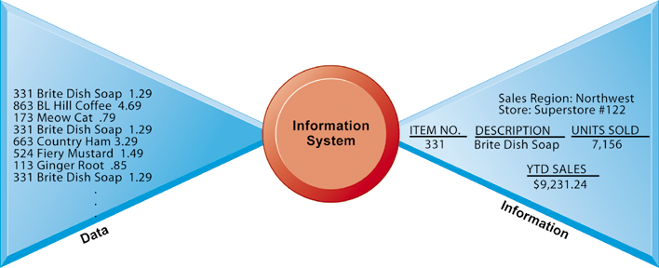
Essentials of Management Information Systems
Chapter 1 Business Information Systems in Your Career
What Exactly Is An Information System?
Data and Information
Data and Information
Raw data from a supermarket checkout counter can be processed and organized to produce meaningful information, such as the total unit sales of dish detergent or the total sales revenue from dish detergent for a specific store or sales territory.
Figure 1.1
Notes:
Emphasize the distinction between information and data. You could, for example, ask several students to list their ages and write the numbers on one side of the board—then you could calculate the average age of those students on the other side, oldest student, youngest student, and so forth, to illustrate the difference between raw data and meaningful information.

Slide 21
Essentials of Management Information Systems
Chapter 1 Business Information Systems in Your Career
What Exactly Is An Information System?
What Is an Information System?
Activities in an information system that produce information:
  Input
  Processing
  Output
  Feedback
Sharp distinction between computer or computer program versus information system
Notes:
Use an example similar to the one given in the previous slide to illustrate the three activities involved in the function of an information system. Continuing with that example, the process of asking students their age would represent input, calculating the average age and determining the oldest and youngest age would represent processing, and writing that information on the board would represent output.

Slide 22
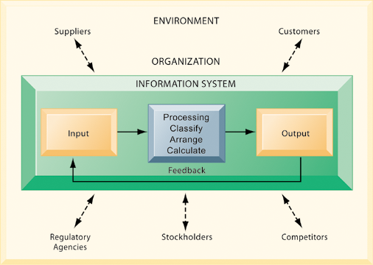
Essentials of Management Information Systems
Chapter 1 Business Information Systems in Your Career
What Exactly Is An Information System?
Functions of an Information System
An information system contains information about an organization and its surrounding environment. Three basic activities—input, processing, and output—produce the information organizations need. Feedback is output returned to appropriate people or activities in the organization to evaluate and refine the input. Environmental actors, such as customers, suppliers, competitors, stockholders, and regulatory agencies, interact with the organization and its information systems.
Figure 1.2
Notes:
The point of this diagram is first of all to highlight the three basic activities of information systems, so that students can understand what an information system is doing at its most fundamental level. But the diagram also puts information systems into the context of organizations (firms), and then puts the firm into its respective environment composed of shareholders, higher level authorities (government), competitors, suppliers, and customers. Suddenly, students should see that information systems play a central role mediating and interacting with all these players. Hence, systems play a key role in the operations and survival of the firm.
You could also explain this diagram by relating it back to the opening case, as the book does. The two types of input into the Synergy system are manually entered data as well as video. The system processes that data and creates the output, video, and statistics about specific types of players and plays.

Slide 23
Essentials of Management Information Systems
Chapter 1 Business Information Systems in Your Career
What Exactly Is An Information System?
The Role of People and Organizations
Information systems literacy
  Includes behavioral and technical approach
Computer literacy
  Focuses mostly on knowledge of IT
Management information systems (MIS)
  Focuses on broader information systems literacy
  Issues surrounding development, use, impact of information systems used by managers and employees
Notes:
It takes many different skills to build and manage information systems.

Slide 24
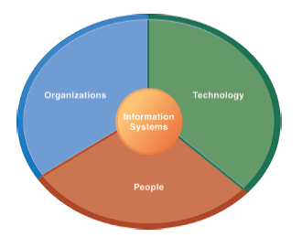
Essentials of Management Information Systems
Chapter 1 Business Information Systems in Your Career
What Exactly Is An Information System?
Information Systems Are More than Computers
Using information systems effectively requires an understanding of the organization, people, and information technology shaping the systems. An information system provides a solution to important business problems or challenges facing the firm.
Figure 1.3
Notes:
These three themes (people, organizations, and technology) will reappear throughout the book. Understanding the interaction between these factors and information systems is known as information system literacy. Knowing how to optimize the relationship between technology, organizations, and people is the purpose of this book and course.

Slide 25
Essentials of Management Information Systems
Chapter 1 Business Information Systems in Your Career
What Exactly Is An Information System?
Dimensions of Information Systems
Organizations
  Coordinate work through structured hierarchy and business processes.
    Business processes: related tasks and behaviors for accomplishing work
      Examples: fulfilling an order, hiring an employee
      May be informal or include formal rules
  Culture embedded in information systems
    Example: UPS's concern with placing service to customer first
Notes:
What types of issues and problems would occur in a company whose information systems did not accurately reflect its culture, or whose hierarchy was overly complex or poorly conceived?

Slide 26
Essentials of Management Information Systems
Chapter 1 Business Information Systems in Your Career
What Exactly Is An Information System?
Dimensions of Information Systems
People
  Information systems require skilled people to build, maintain, and use them.
  Employee attitudes affect ability to use systems productively.
  Role of managers
    Perceive business challenges.
    Set organizational strategy.
    Allocate human and financial resources.
    Creative work: new products, services.
Notes:
The “people” dimension of systems is often the most difficult to get right. Technologies change all the time, people do not change very rapidly. In order to use technologies effectively, people need training, and they need to think intelligently about how their business works. Managers are the employees who attempt to understand organizational issues and challenges, and then use technologies to solve the issues and meet the challenges.

Slide 27
Essentials of Management Information Systems
Chapter 1 Business Information Systems in Your Career
What Exactly Is An Information System?
Dimensions of Information Systems
Technology
  IT Infrastructure: Foundation or platform that information systems built on
    Computer hardware
    Computer software
    Data management technology
    Networking and telecommunications technology
      Internet and Web, extranets, intranets
      Voice, video communications
Notes:
Obviously, information systems are based on technologies—computer hardware and software, telecommunications equipment. These technologies are like the infrastructure of a building—the plumbing and electrical and mechanical features in a building. Technology is the platform that enables all the common systems applications from Apple iPhones to the Internet.

Slide 28
Essentials of Management Information Systems
Chapter 1 Business Information Systems in Your Career
UPS Competes Globally with Information Technology
Interactive Session: Technology
UPS Competes Globally with Information Technology
Read the Interactive Session and then discuss the following questions:
  What are the inputs, processing, and outputs of UPS's package tracking system?
  What technologies are used? How are these technologies related to UPS's business strategy?
  What strategic business objectives do these systems address?
  What would happen if these technologies were not available?
Notes:
Ask students if they have ever signed for a package using a device like the DIAD. How important are technologies like these to UPS's bottom line? There's an interesting video case study on the UPS DIAD in the Case Study package. You could show this video during class.

Slide 29
Essentials of Management Information Systems
Chapter 1 Business Information Systems in Your Career
Solving Information System-Related Problems
The Problem-Solving Approach
Few business problems are simple or straightforward.
Most business problems involve a number of major factors that can fall into three main categories:
  Organization
  Technology
  People
Notes:
Ask students to think about the jobs they have held in the past, and then describe some of the common business problems they faced, the factors involved, and what category these factors fall into.

Slide 30
Essentials of Management Information Systems
Chapter 1 Business Information Systems in Your Career
Solving Information System-Related Problems
A Model of the Problem-Solving Process
Problem solving: four-step process
  Problem identification
  Solution design
  Choice
  Implementation

Slide 31
Essentials of Management Information Systems
Chapter 1 Business Information Systems in Your Career
Solving Information System-Related Problems
A Model of the Problem-Solving Process
Problem identification includes:
  Agreement that problem exists
  Definition of problem
  Causes of problem
  What can be done given resources of firm
Notes:
Ask students about their job experiences with problem identification. Usually, there are different points of view about what the problem actually is. There often is no agreement on the problem.

Slide 32
Essentials of Management Information Systems
Chapter 1 Business Information Systems in Your Career
Solving Information System-Related Problems
A Model of the Problem-Solving Process
Typical organizational problems
  Outdated business processes
  Unsupportive culture and attitudes
  Political in-fighting
  Turbulent business environment, change
  Complexity of task
  Inadequate resources
Notes:
Ask students to describe if any of these typical business problems arose in their work experience.

Slide 33
Essentials of Management Information Systems
Chapter 1 Business Information Systems in Your Career
Solving Information System-Related Problems
A Model of the Problem-Solving Process
Typical technology problems
  Insufficient or aging hardware
  Outdated software
  Inadequate database capacity
  Insufficient telecommunications capacity
  Incompatibility of old systems with new technology
  Rapid technological change
Notes:
Once again, draw students out and ask them to speak about the technology problems they have experienced in their work.

Slide 34
Essentials of Management Information Systems
Chapter 1 Business Information Systems in Your Career
Solving Information System-Related Problems
A Model of the Problem-Solving Process
Typical people problems
  Lack of employee training
  Difficulties of evaluating performance
  Legal and regulatory compliance
  Work environment, ergonomics
  Poor or indecisive management
  Lack of employee support and participation

Slide 35
Essentials of Management Information Systems
Chapter 1 Business Information Systems in Your Career
Solving Information System-Related Problems
A Model of the Problem-Solving Process
Solution design
  Often many possible solutions
  Consider as many as possible to understand range of solutions
Solution Evaluation and Choice: Factors include
  Cost
  Feasibility given resources and skills
  Length of time needed to implement solution
Notes:
Why are there so many solutions to a problem? How many solutions can be seriously examined and explored?
Why should implementation be considered in the problem solving process? One reason is that you want to avoid solutions that cannot be easily implemented.

Slide 36
Essentials of Management Information Systems
Chapter 1 Business Information Systems in Your Career
Solving Information System-Related Problems
A Model of the Problem-Solving Process
Implementation
  Building or purchasing solution
  Testing solution, employee training
  Change management
  Measurement of outcomes
  Feedback, evaluation of solution
Problem solving is a continuous process, not a single event
  Sometimes chosen solution doesn't work or needs adjustment
Notes:
Why aren't problems solved once and for all? Some problems might be “solved” and forgotten, and lack of attention leads to the problems arising again.

Slide 37
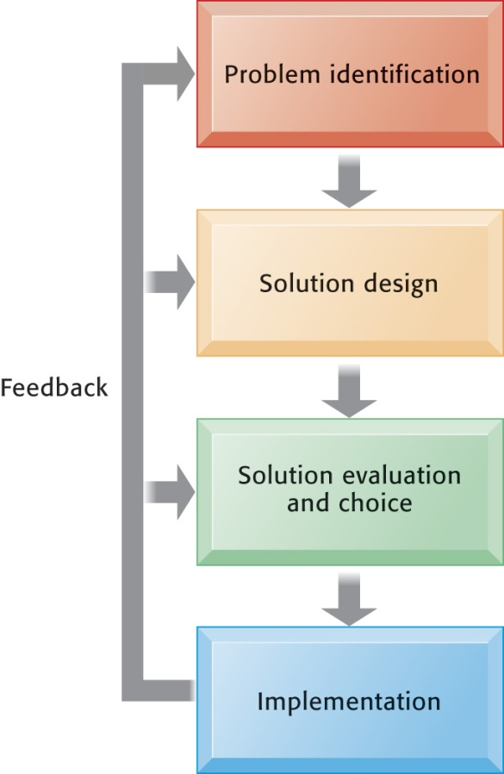
Essentials of Management Information Systems
Chapter 1 Business Information Systems in Your Career
Solving Information System-Related Problems
Problem Solving Is a Continuous Four-Step Process
During implementation and thereafter, the outcome must be continually measured and the information about how well the solution is working is fed back to the problem solvers. In this way, the identification of the problem can change over time, solutions can be changed, and new choices made, all based on experience.
Figure 1.4
Notes:
What makes problem solving continuous is that most solutions don't always work perfectly and need fine tuning. Some decisions result in actions that don't work at all, or work perfectly (at least for a period of time). In any case, you need continuous feedback from the environment to track how well solutions are working.

Slide 38
Essentials of Management Information Systems
Chapter 1 Business Information Systems in Your Career
Solving Information System-Related Problems
The Role of Critical Thinking in Problem Solving
Without critical thinking, easy to jump to conclusions, misjudge a problem, and waste resources
Critical thinking:
  Sustained suspension of judgment with an awareness of multiple perspectives and alternatives

Slide 39
Essentials of Management Information Systems
Chapter 1 Business Information Systems in Your Career
Solving Information System-Related Problems
The Role of Critical Thinking in Problem Solving
Four elements of critical thinking:
  Maintaining doubt and suspending judgment
  Being aware of different perspectives
    Including technology, organization, and people perspectives
  Testing alternatives and letting experience guide
  Being aware of organizational and personal limitations
Notes:
Why should these elements of critical thinking be an issue at all? Why should it be hard to suspend judgment? Be aware of different perspectives? Test alternatives? Be aware of limitations?

Slide 40
Essentials of Management Information Systems
Chapter 1 Business Information Systems in Your Career
Solving Information System-Related Problems
The Connection Between Business Objectives, Problems, and Solutions
When firms cannot achieve business objectives these objectives become challenges.
Information systems often present solutions, partially or fully, to these challenges.
Notes:
If your objective is to increase sales of a new line of clothing, and then sales don't increase, at the very least a business has a challenge (if not an outright “problem” that needs solving).

Slide 41
Essentials of Management Information Systems
Chapter 1 Business Information Systems in Your Career
How Will Information Systems Affect Business Careers?
Success in today's job market requires a broad set of skills.
Job candidates must have problem-solving skills as well as technical skills so that they can complete specific tasks.
The service sector will account for 95 percent of the new jobs that are created or open up by 2022
Notes:
Just having one set of skills is not a very wise idea when preparing for future labor markets. The more skills you have (say English language skills or any language skills plus information systems skills plus some finance skills) the greater your attractiveness to future employers who may see you as a multi-skilled person who could fit into a variety of jobs.

Slide 42
Essentials of Management Information Systems
Chapter 1 Business Information Systems in Your Career
How Will Information Systems Affect Business Careers?
How Information Systems Will Affect Business Careers
Accounting:
  Accountants increasingly rely on information systems to summarize transactions, create financial records, organize data, and perform financial analysis.
  Skills:
    Knowledge of databases and networks
    Online financial transactions and reporting systems
    How systems are used to achieve accounting functions

Slide 43
Essentials of Management Information Systems
Chapter 1 Business Information Systems in Your Career
How Will Information Systems Affect Business Careers?
How Information Systems Will Affect Business Careers
Finance:
  Relationship between information systems and financial management and services is so strong that many advise finance majors to co-major in information systems.
  Skills:
    Use systems for financial reporting, direct investment activities, implement cash management strategies
    Plan, organize, implement information systems strategies for the firm

Slide 44
Essentials of Management Information Systems
Chapter 1 Business Information Systems in Your Career
How Will Information Systems Affect Business Careers?
How Information Systems Will Affect Business Careers
Marketing:
  No field has undergone more technology-driven change in the past five years than marketing and advertising.
  Skills:
    Work with databases for tracking and reporting on customer behavior, product performance, customer feedback, product development
    Enterprise systems for product management, sales force management, customer relationship management

Slide 45
Essentials of Management Information Systems
Chapter 1 Business Information Systems in Your Career
How Will Information Systems Affect Business Careers?
How Information Systems Will Affect Business Careers
Operations management in services and manufacturing:
  Production managers, administrative service managers, and operations analysts
  Skills:
    Hardware and software platforms for operations management
    Use database and analytical software for coordinating and optimizing resources required for producing goods and services

Slide 46
Essentials of Management Information Systems
Chapter 1 Business Information Systems in Your Career
How Will Information Systems Affect Business Careers?
How Information Systems Will Affect Business Careers
Management:
  The job of management has been transformed by information systems.
  Impossible to manage business today without information systems.
  Skills:
    Use of information systems for each function of job, from desktop productivity tools to applications coordinating the entire enterprise

Slide 47
Essentials of Management Information Systems
Chapter 1 Business Information Systems in Your Career
How Will Information Systems Affect Business Careers?
How Information Systems Will Affect Business Careers
Information systems:
  Fast changing and dynamic profession because information technologies are among most important tools for achieving business firms' key objectives
  Domestic and offshore outsourcing
  Skills:
    Uses of new and emerging hardware and software to achieve six business objectives
    An ability to take a leadership role in the design and implementation of new information systems

Slide 48
Essentials of Management Information Systems
Chapter 1 Business Information Systems in Your Career
How Will Information Systems Affect Business Careers?
How Information Systems Will Affect Business Careers
Outsourcing and offshoring:
  Two types: outsourcing to domestic U.S. firms and outsourcing to low-wage countries such as India, China
  Production programming, system maintenance, call centers
  Benefits:
    Lower cost of building and maintaining systems within U.S.
    Increased need for managerial positions

Slide 49
Essentials of Management Information Systems
Chapter 1 Business Information Systems in Your Career
How Will Information Systems Affect Business Careers?
How Information Systems Will Affect Business Careers
Common requirements for all majors
  How IT helps achieve six business objectives
  Central role of databases
  Business analytics and intelligence systems
  Working with specialists and systems designers
  Ethical, social, legal environment and issues
    Use of IT to meet legal requirements
Notes:
All of the occupational areas discussed in this section require some level of information systems skills and knowledge. IS is a major lever of organizational change in the future, and very important for achieving new levels of productivity. The future will be very rich in digital information. Learning how to make sense out it will be a very valuable skill.

